Slide 1
TAMS Specifications
Dr Robert Leonard & Michael O’Donoghue
15th April 2025
An Roinn Talmhaíochta, Bia agus Mara │ Department of Agriculture, Food and the Marine

Slide 2
Introduction
Brief overview of specifications
S.101
S.123
Explanatory Notes on Costings
Website

Slide 3
S101 - Minimum Specification for the Structure of Agricultural Buildings
Outlines minimum requirement for Tams grant aided farm buildings
Other structural designs outside scope of S101 – report to be submitted from chartered engineer, submitted to Department for prior approval
The contractor must be certified to EN 1090-1, even in cases where the steel frame is manufactured on site
Where the building is being grant-aided, and the applicant manufactures the steel frame themselves, then the applicant shall submit up-to-date certificates of welding competence in accordance with EN ISO 9606-1:2013.

Slide 4
Building Types
Simple Steel Frame – A2
Lean-To Structure – A3
Steel Frame with Steel Truss Roof – A4
Steel Portal Frame – A5
Simple Timber Frame – A6
Timber Portal Frame – A7
Traditional Solid Wall with Timber Roof – A8
Concrete Framed Structure – A9
Steel Hooped Structure – A10

Slide 5
S.101: Overground buildings
Covers full building requirements
Wide range of building design options
Design to 4.8m or 6.4m bays – most cost effective.
Grafting to existing buildings
Stanchion to be suitable for both buildings
Need to provide details of exiting building
Stanchion elimination
Design is for simple steel frames up to 9.15m span, 4.8m bay and 3.0m eave
Portal frames always require engineers report.

Slide 6
Figure 3 - Single-sided simple steel frame house (4 bay)

Slide 7
Figure 4 Double-sided simple steel frame house

Slide 8
S.101: Overground buildings
Stanchion sizes – ensure correct for eave height
Offset Apex – may need to design to portal frame
Both overhangs are 3.5m or less, simple steel frame sizing
One or both overhangs is greater than 3.5m and both less than 4.0m, simple steel frame sizing applies, but knee and apex braces as in steel portal frames shall be incorporated
One or both overhangs is greater than 4.0m, then full portal frame specification applies

Slide 9
S.101: Overground buildings

Slide 10
S.101: Overground buildings
Internal agitation points must be removed
Common airspace with other buildings
Ventilation –
Ensure gap over vented sheeting at sides for buildings over 15m wide
Ensure outlet ventilation is correct size
Do not impede ventilation of existing buildings
Purlin sizing
Timber purlins – up to 4.8m
Steel purlins must be pre-painted and listed on S.102

Slide 11
Concrete for all structures
Concrete – either 37N or 45N – legal minimum requirement regardless of grant-aid for slurry and effluent stores.
Always from a plant certified to EN 206
Required strength important for durability.
Cement Content and Water Cement Ratio are important

Slide 12
S123 - Minimum Specification for Bovine Livestock Units and Reinforced Tanks
Bovine housing layout
Loose, slatted, suckler and cubicle houses
Tank layout
Space at agitation points and tank lengths
Required reinforcing levels
Floor and wall thickness
Tank covers (slabs and slats)

Slide 13
S.123: Bovine building layout and tank design
Access to pens not through other pens
Cubicle cross-over points
2.3m wide minimum
3.5m wide if drinker present- clear space.
Cubicle bed dimensions
2.1m head-to-head, 2.4m recommended
2.4m long against wall, recommend 2.6m
1.15m wide (c/c dividers)
Precast cubicle beds
Must be on Accepted Slat List
On HD slats or slabs only, or self supporting

Slide 14
S.123: Bovine building layout and tank design
All internal agitation points must be removed
All Buildings shall be designed so that there is good air-flow around agitation points
Sufficient space at agitation points
9 metres between gables
6 metres at sides
6 metres gable to side
9 metres from agitation point to at least one wall when three sides
Avoid common air-space with building with internal agitation points

Slide 16
S.123: Bovine building layout and tank design
Agitation points both ends:
Type “A” & Type “B” tanks shall not be longer than 42m
Type “C” tanks shall not be longer than 32m
Agitation points at one end only:
Type A & B tanks: shall not exceed 25.5m in length
Type C tanks: shall not exceed 16m in length
Pipe Agitation system:
Tank length up to 37m for single agitation point
Tank length up to 61m for two agitation points
Aeration System:
Tank length up to 75m
Extraction points every 50m

Slide 17
S.123: Bovine building layout and tank design
Foundations under stanchions always brought down to firm strata
Foundations outside tank walls to be of mass concrete – never use blocks.
Wall thickness
Minimum 225 mm for outer walls.
Minimum 300 mm for spine walls
Minimum 400mm for stanchion (outer wall), 500mm for spine wall.
Additional reinforcing required under stanchions on tank walls.
Stanchions on beams – beam must be specifically designed

Slide 18
Engineers Reports for S.101 and S.123
Can enable any design to be used.
Must be agreed by DAFM prior to work being undertaken.
Must be completed by a Chartered Engineer.
Must provide detail of works and calculations.
Required for all pillar and beam spine walls.
Required if eave height above 5m.

Slide 19
11 Schemes Under TAMS 3
AWNSS – Animal Welfare Scheme
WFCIS – Women Farmers Scheme
YFCIS – Young Farmers Scheme
OCIS – Organics Scheme
TCIS – Tillage Scheme
PPIS – Pig and Poultry Scheme
DES – Dairy Equipment Scheme
FSS – Farm Safety Scheme
LESS – Low Emission Slurry Spreading Scheme
SCIS – Solar Scheme
NISS – Nutrient Importation Storage Scheme

Slide 20
Drawing Quality
Drawings must be clear and to scale.
Neighbouring buildings should be shown
All relevant dimensions must be shown
Required dimensions given in T&Cs
Plan and elevations required
All agitation points must be shown
External and Internal
Farmyard plan must be clear and to scale

Slide 21
Explanatory Notes on Costings
These are essential for completing an application or claim.
These give the required measurement points and units for each investment.
Every investment is covered by the Explanatory Notes on Costings.
Investments divided into groups of similar type investments.
Failure to follow will delay approvals and payments, and may lead to penalties.

Slide 22
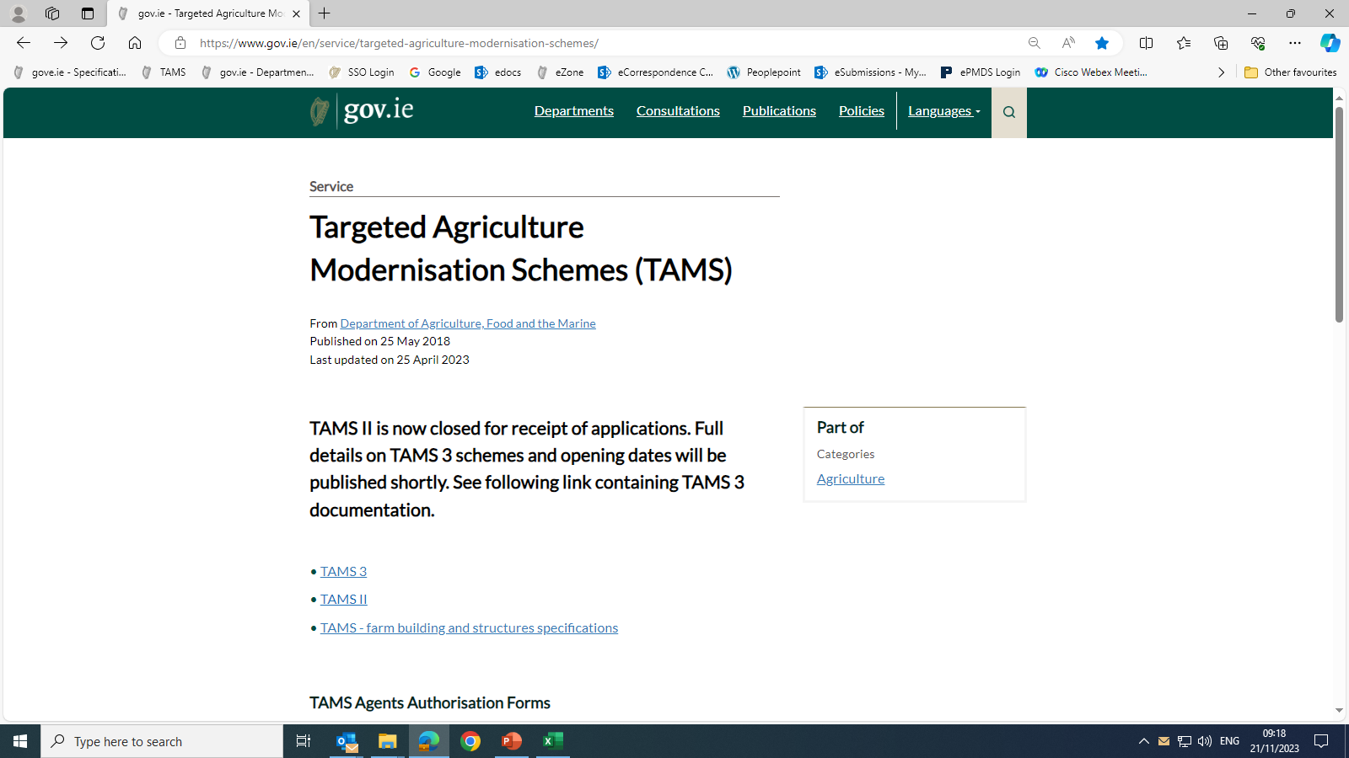

Slide 23
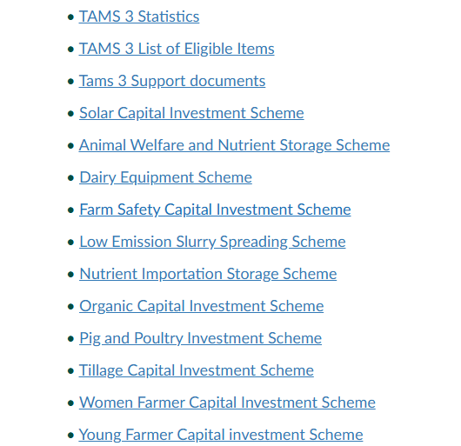
TAMS 3 T&C’s gov.ie - Targeted Agriculture Modernisation Schemes (TAMS) (www.gov.ie)

Slide 24
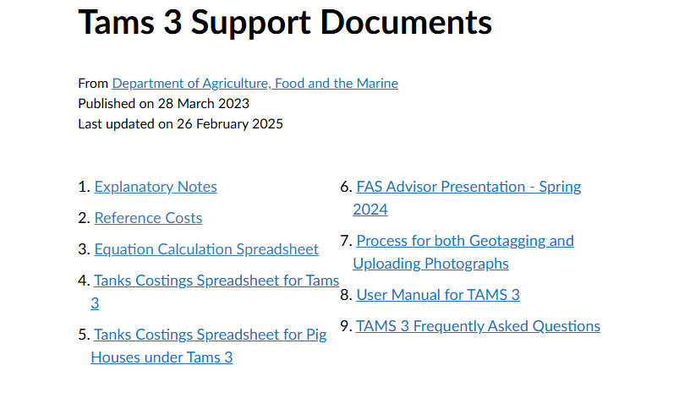
TAMS 3 gov.ie - Tams 3 Support documents (www.gov.ie)

Slide 25
General Issues
Consult website
Updates in specifications are highlighted in red
List of when updates occurred at top of specification page
Specifications are updated regularly.
The list of relevant specifications are given on the Approval letter and must be followed.

Slide 26
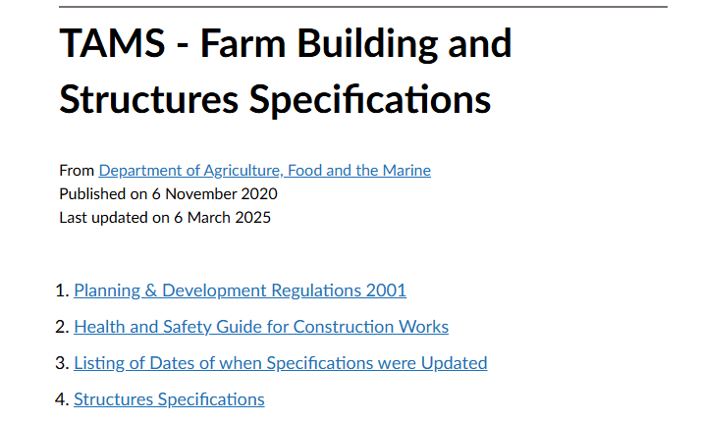
TAMS Specifications gov.ie - TAMS - Farm Building and Structures Specifications (www.gov.ie)

Slide 27
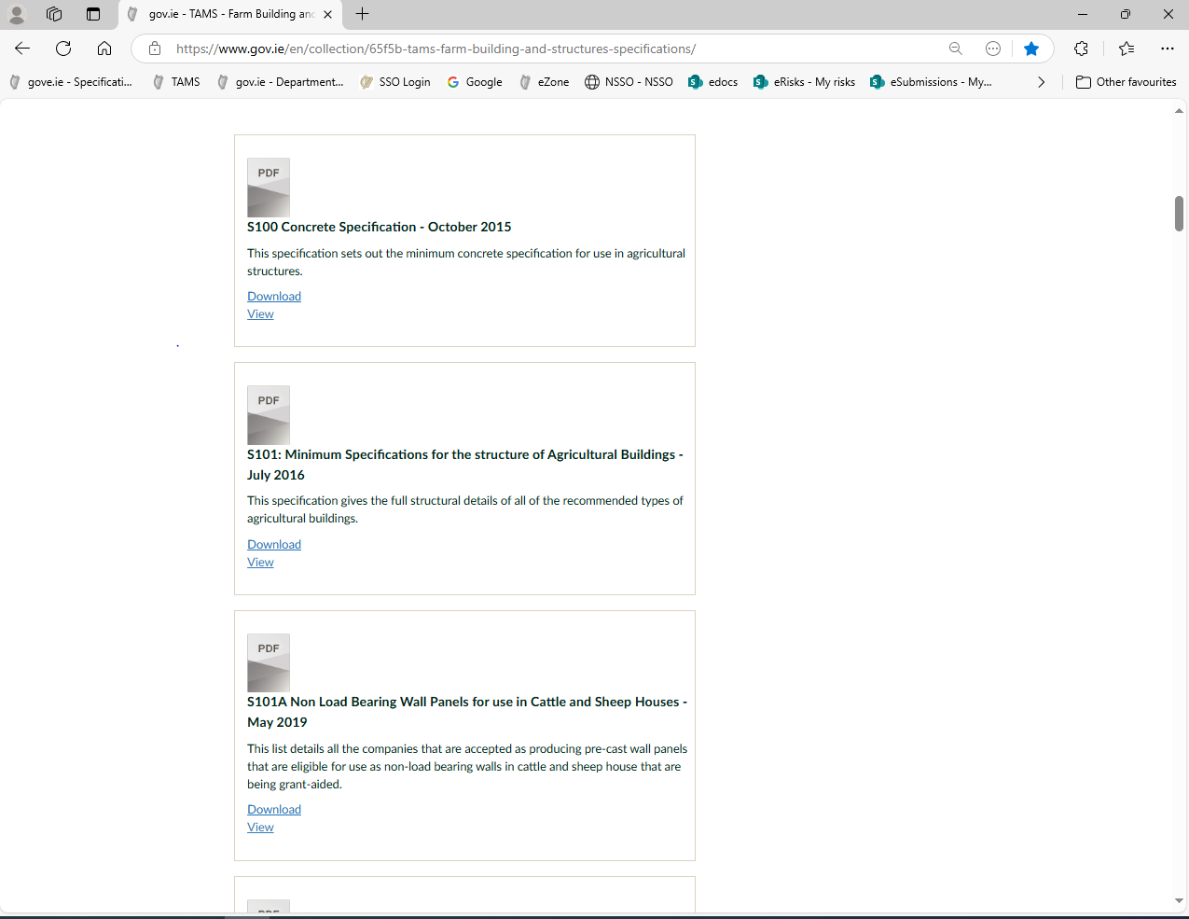

Slide 28
General
Read the Specifications
Get to know the specifications
Consult the specifications

Slide 29
Thank you for your attention.

